Slide 1
inos pathway for figure

Slide 2
KEGG draft
epithelial cell
TRAF3IP2
IL17C
IL17RA/RE
Act1
MAPK 11/12/13/14
FOS, FOSB, JUN, JUND, FOSL1
p38
AP-1
MAPK signalling
MAPK 1/3/8/9/10
TIRAP
TLR 4
IRAK4
IRAK1/2
TRAF6
TRAF6
PA14
MyD88
nucleus
TLR 2/6
JAK2
STAT1
JAK1/2
NF-kb signalling
DNA
PA14
NFKB1, RELA
TLR 9
PA14
RIPK2
MAP3K7, TAB1/2/3
NOD1/2
RIP2
TAK1 / TAB
inflammatory / antimicrobial
S100A 7/8/9
iNOS / nos2
NOX / DUOX
IL1b/IL-6/IL-8

Slide 3
KEGG map05152 Tuberculosis and map05140 Leishmaniasis
macrophage/ dendritic cell
JAK/STAT signaling pathway
IFNGR1
IFNG
JAK1/2
STAT1
NOS2
IFNGR2
MAPK signaling pathway
TLR signaling pathway
p38
TLR2
TIRAP
PA14
IRAK4
IRAK1/2
TRAF6
ERK1/2
NOS2
TLR1/6
Myd88
JNK
TLR4
Notes:
use a JAK/STAT Inhibitor to proof?

Slide 4
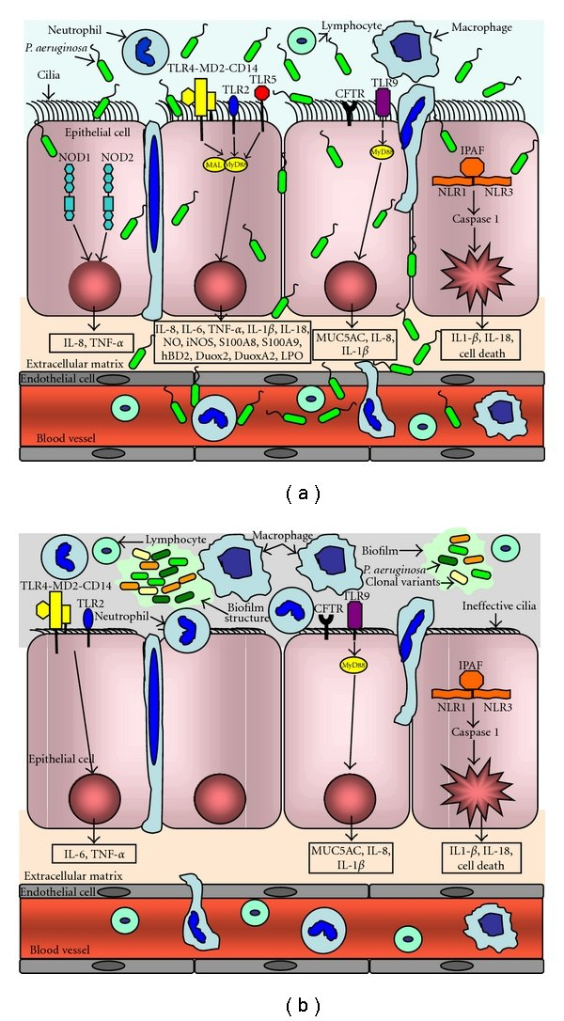
Based on following KEGGs:
map04657 IL-17 signaling pathway
hsa05152 Tuberculosis
hsa04621 NOD-like receptor signaling pathway
DOI:
10.1155/2011/852513

Slide 5
Pathway overview draft
Arginine metabolism
ASS1, ARG2
Inflammatory stimuli (eg LPS via TLRs)
inflammatory signalling
(JAK2, STAT1, nfkb, SMAD)
L-Arginine + O2
iNOS / NOS2
antioxidant enzymes (SOD2,
nitrosative/oxidative antimicrobial stress
NO + Citrullin

Slide 6
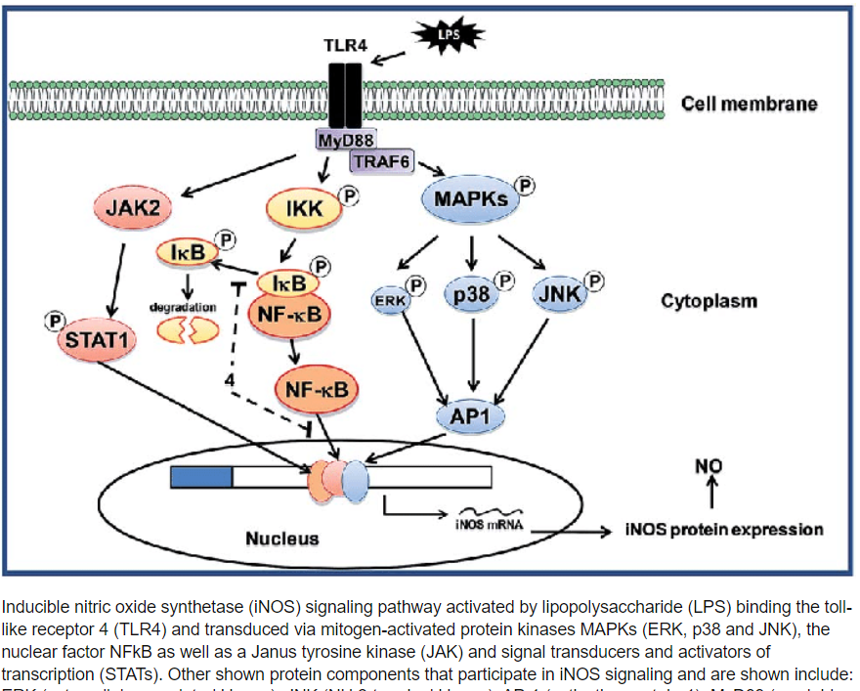
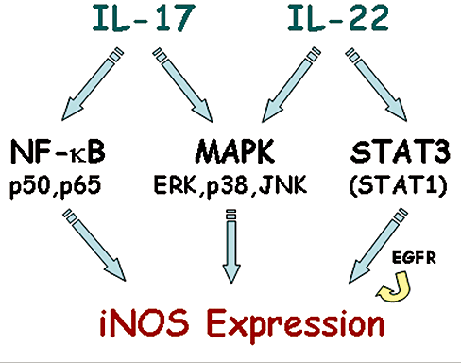
Pathway draft regulation
DOI:10.1039/C5RA07511D
NOS2 induced by:
NF-κB via IL1b, TNF and IL17
STAT1α and IRF1 via the IFNg/stat axis

Slide 7
In epithelial cells, the combined action of some cytokines, being the most important interleukin 1β (IL-1β), interferon γ (IFN-γ), and tumor necrosis factor α (TNF-α), and/or some proinflammatory stimuli such as lipopolysaccharides (LPS) triggers the activation of the transcription factors involved in the induction of iNOS gene expression
after recognition by epithelial receptors, such as Toll-like Receptor 4 (TLR4) in the case of LPS (Jia et al., 2016), INFγ receptor, TNF receptor or IL-1 receptor. In epithelial cells, IL-1β and TNF-α stimulation induce the activation and translocation into the nucleus of nuclear transcription factor κB (NF-κB). However, INF-γ stimulation activates STAT-1 and IRF-1
AP-1 is another important transcription factor for iNOS expression in airway epithelial cells. Stimulation with LPS and INF-γ activates mitogen-activated protein kinase (MAPK) pathways enhancing the binding of AP-1 protein to specific promoter sequences.

Slide 8
Sources
reactome hat vllt gute infos
Inos regulation: Inducible NO synthase and antibacterial host defence in times of Th17/Th22/T22 immunity - Mühl - 2011 - Cellular Microbiology - Wiley Online Library
QuickGO::Term GO:0006809 (ebi.ac.uk) nitric oxide biosynthetic process
QuickGO::Term GO:1904407 (ebi.ac.uk) positive regulation of nitric oxide metabolic process
GO:0051767 nitric-oxide synthase biosynthetic process
GO:0051770 positive regulation of nitric-oxide synthase biosynthetic process

Slide 9
doi: 10.1128/spectrum.02408-22
The RNA-seq data of P. aeruginosa and human airway organoids that support the findings of this study have been deposited in the NCBI Sequence Read Archive (SRA) with the accession numbers PRJNA835709 and PRJNA836155, respectively
maybe we can download their data and re-analyse to confirm sth / complement our findings with the seq data from PAO1 ?

